Slide 2

WHO WE ARE
TIDZ is the focal point for investors seeking support to invest in North Macedonia free economic and industrial zones.
14 free economic zones available with ready-to-use infrastructure and other favorable conditions.

Slide 3
CURRENT PORTFOLIO
35 capacities, owned by foreign investors from USA, Canada, S.Korea, Germany, Italy, Turkey..
These companies generated approx. EUR 3 bn of exports in 2021 (record high) which equals to 47% of North Macedonia exports.
The good investment conditions and support packages contributed to increased economic activities in the free zones, even in the pandemic 2020.

Slide 4
DTIDZ - Highest economy activities in four years
Highest economy activity in the zones in 2021.
The export grew by 15% in comparison to the 2019 and 22% compared to 2018, making it the record-high in the last 4 years.

Slide 5
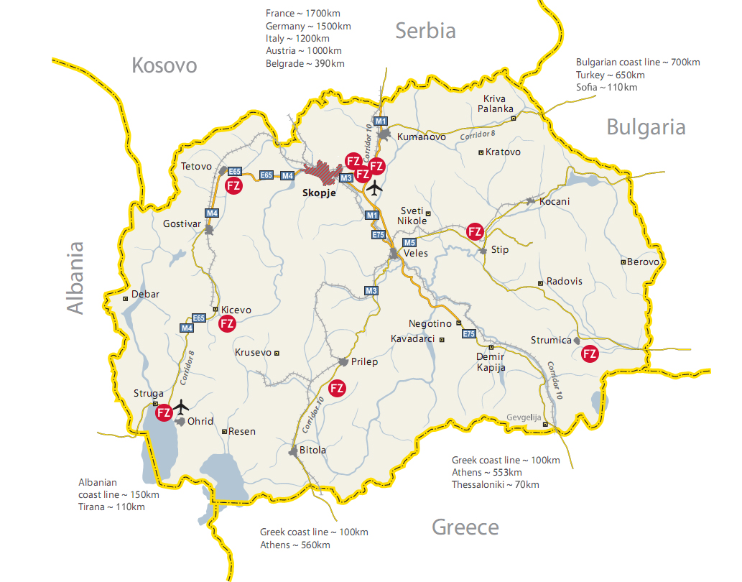
LOCATION

Slide 6
STABLE MACROECONIMIC INDICATORS
REAL GDP GROWTH RATE (%)
INFLATION
Low inflation: avg < 2% annually over the last 18 years
NBRNM projections 2022 – 7.2%
2023 – 3,5%
IMF Projections 2022 – 6,9%
2023 – 3,6%
EXPORT GROWTH RATE (%)
CURRENCY
North Macedonian Denar pegged to the DM/€
for the last 26 years (€1= MKD 61.5)
FDI (% of GDP)
AVERAGE NETTO SALARY IN 2021
€490 per month
Source: SSO and MoF; * Projection

Slide 7


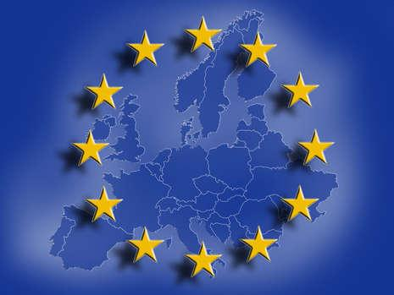
POLITICAL STABILITY
Independence from 1991
UN member from 1993
Free trade agreement EU – SAA 2001
Candidate status EU - 2005
NATO membership since 2019
Last Parliamentary elections 2020 (with mandate to 2024)
Last Presidential elections 2021 (with mandate to 2024)

Slide 8


FREE TRADE AGREMENTS
EU – European Union (27 countries)
EFTA – European Free Trade Association (4 countries)
CEFTA – Central European Free Trade Agreement (7 countries)
Bilateral Free Trade Agreements with:
Turkey and Ukraine
*provide access to markets in 40 countries with 600 million consumers

Slide 9
THE INVESTORS

Slide 10







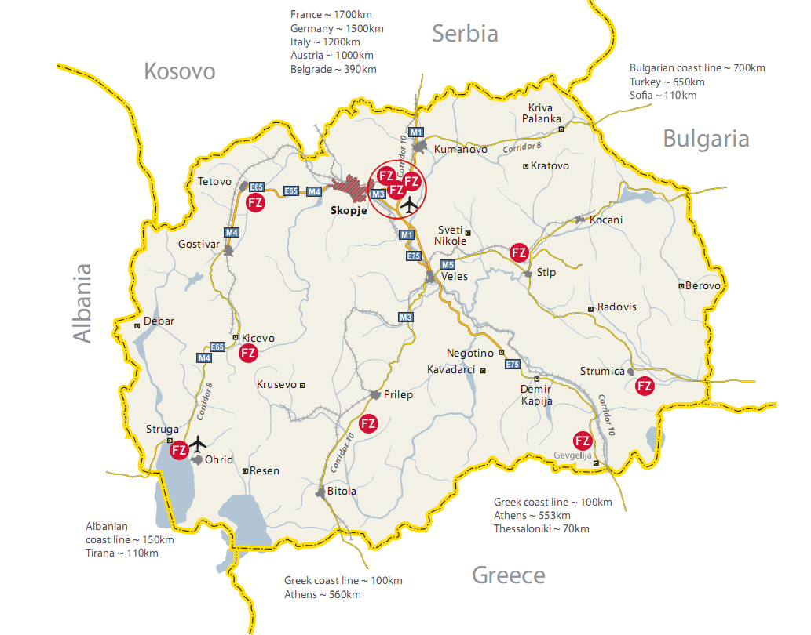






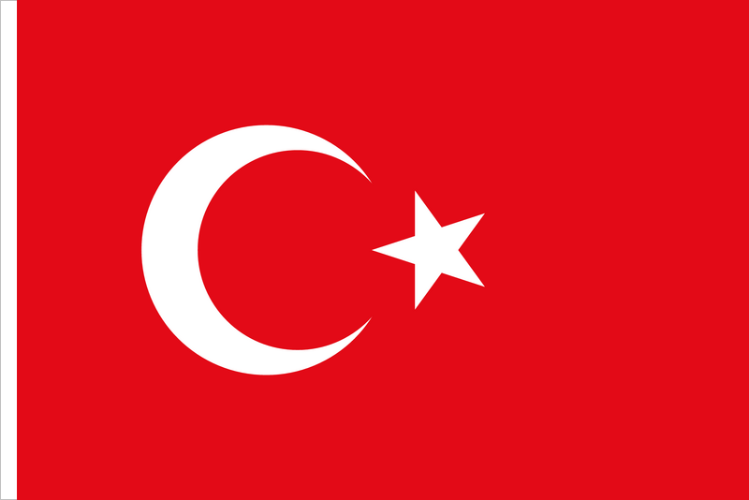








Major recent investors in Greenfield sites
Plant 1: €80M; 350 employees; Exhaust catalyst manufacturer; The biggest exporter from Macedonia
Plant 1: 500 employees; Aluminum exterior parts
€15M; 500+ employees;
Production of electronic and safety components
Plant 1: €25M; 800 employees; Production of buses and coaches for the US and EU markets;
Plant 2 & 3: €70M; 1000 employees; Aluminium battery frames & Aluminium extrusions
Plant 2: €65M; 550+ employees;
Second investment stage: €15M; 450+ employees
€15M; 400 employees;
Production of airbag inflators
€30M; 500 employees;
Production of electrical capacitors
€10M; 200 employees;
Global leader in paper surface treatments and polymeric films
Plant 1: €10M; 150 employees;
Production of armored high-pressure rubber hoses;
Plant 2: €11M; 150 employees;
€6M; Up to 300 people; Production of wiring harness and cables
€30M+; 400 employees;
Packaging for the pharmaceutical and cosmetics industry
Ramp-up of up to 300 employees; Production of wiring harness and cables
Ramp-up of up to 300 employees; Production of polyurethane parts for automotive industry
€20M; 300 employees; Production of sophisticated electrical components
€5M; Up to 200 people; Production of sensors, encoders, and measuring instruments.

Slide 11





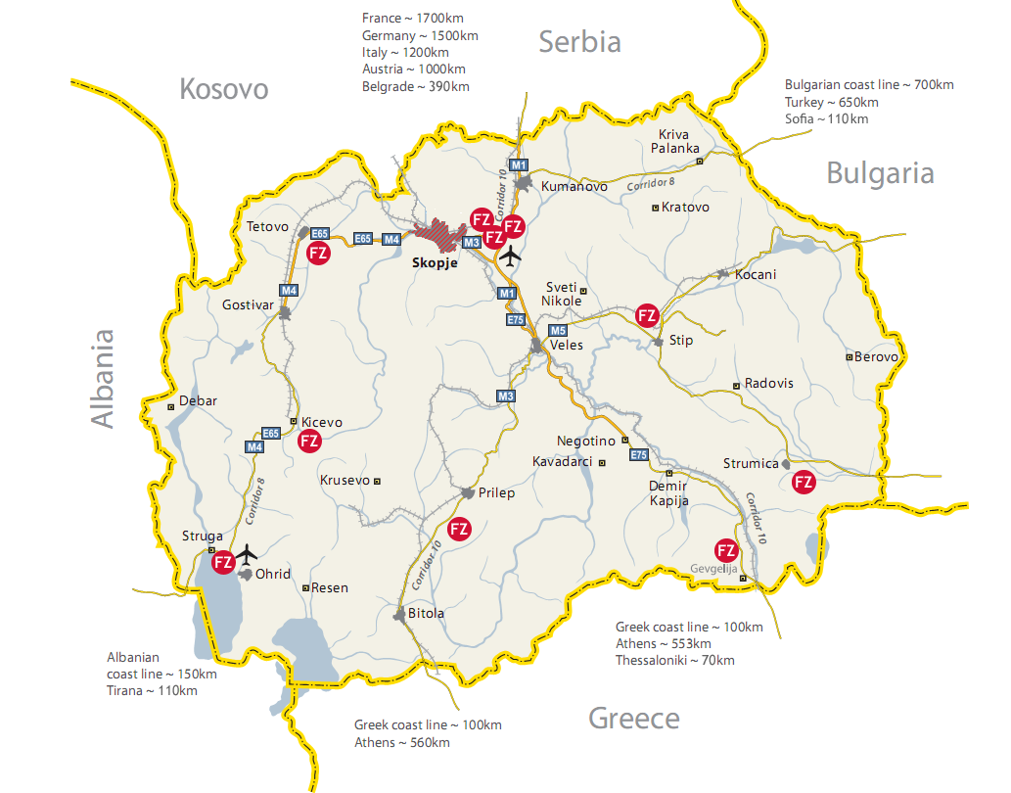









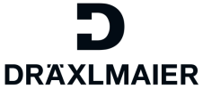
Major recent investors in Greenfield sites
Over €15M; 2,000 employees; Production of airbag cushions and modules
€15M+; Ramp-up of up to 3,000 employees;
Production of seat covers
€35M; 750 employees; Production of PCBs, plastic and molded containers and final assembly
€30M+; Rump-up to 2,500 employees; Production of interconnect products
€70M+; 1,000 employees;
Production of mechatronic and electronic products
€15M; 500 employees;
Production of industrial woven fabrics (insulating materials)
€15M; 1,200 employees;
Production of cables, solenoids and mechatronics
€40M; 250 employees;
Production of of wall-hung boiler components
Ramp-up of up to 1,000 employees; Production of automotive mirrors and components
Cut&trim plants for seat covers
Plant 1, Free Zone Stip:
€20M; 2,100+ employees
Plant 2, Fre Zone Strumica: €20M; 1,500 employees
€20M ; 2,000 employees; Production of seat and steering wheel climate technologies
€12M; Up to 1,200 employees;
Production of electrical appliances and devices
€25M+; 6,200 employees;
Production of wires and cables;
Second phase expansion
€35M; 6,000+ employees;
Production of wiring harness and electrical management systems
€3M+; 250 employees; Plastic injection molding of car parts

Slide 12
TNE NEW CONCEPT

Slide 13
What do we offer
Newly introduced One-stop service approach for support closely following international practice to ensure investors benefit.
Focus on high-quality investments.
Individualized investors package based on the investors 10 year projections on revenues, profits, employments and salaries.

Slide 14
State support – structure
Standard structure:
10% on CAPEX + 10% on competitiveness
Introducing a new approach (Flexible structure)
Business plan analysis (focusing on the period of return on investment for the state, amount of salaries, profit, previous movements - balance sheets)
Up to 10 years exemption from (or paid subsidies) personal and income tax
Maximum cumulation: up to 50% of eligible investment costs
Flexibility in contracts (cut-off after 36 - 48 months for assessment of the degree of realization of the investment plan and "negotiations" for adjustment)
"Moving" limits on annual payments, depending on available budget funds
Shortening the CAPEX payment period and competitiveness (investment period + 1)
Increasing participation in cash measures vs. subsidies / exemptions in the overall structure

Slide 15
Incentives
Among incentives offered the Government provides:
Up to 50% Government support in the max period of 10 years - We are flexible and focused on providing tailor-made solutions
R&D measure - refinement (50% return on investment)
Cash swap for subsidies for paid personnel and profit tax n-2 (shortening the period of completion of "tax" measures, with a certain discount)
State support mechanism packages for staff training aiming increased productivity.
Different elements can be included in the schemes:
10-year tax holiday for profit and corporate tax and 100% reduction of personal income tax for a period of up to 10 years.
Support growth of capital investments and income with a return of 10+10% of investment costs in new machines and equipment or investment in buildings
Exemption on paying utility taxes to the local municipality, and fees for land building permits

Slide 16




Incentives – infrastructure,land and construction
Incentives - infrastructure,land and construction
Infrastructure type:
Utility / service
Energy (including connection to the main power lines in the country)
Transport (including connection to the main road / rail corridors in the country)
Service + (new services for accommodation of workers from and outside the country, education, child care and health)
Long-term lease on land in free zones in Republic of North Macedonia up to 99 years at concessionary prices
We offer service for construction and lease of facilities
(option) The Directorate for TIDZ to finance, build and lease facilities for investors
Access to newly established service for build&lease facilities - investors are offered possibility to buy land.
Free connection to natural gas, water and sewage network.
Each individual offer can consist of all or part of these elements, with different share in overall accumulation and varying intensity.

Slide 17
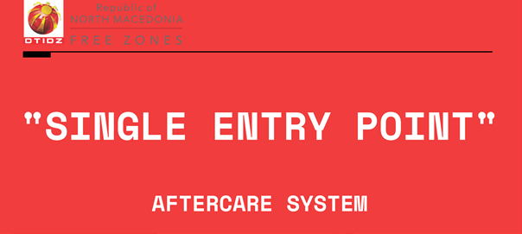
After care
Single Entry
Point concept
Three pillars support services –
Newly introduced fast track protocols with other institutions
Personalized support -
Each company has own unique single contact person for direct communication
Digitalized process/online problem report

Slide 18
Results 2021 – The new concept
New agreements (signed and / or in the phase of formal approval by the Government) in TIDZ with a total investment volume of 188 million euros.
Creation of 2700new jobs

Slide 19
Targets 2024
1 billion eur. investment volume and creation of 14,000 jobs in the next 3 years
We are currently negotiating with 30 companies - a total investment volume of 500 million and creation of 8,500 new jobs

Slide 20
FDY DATA ANALYSIS
2010 – 2020

Slide 21
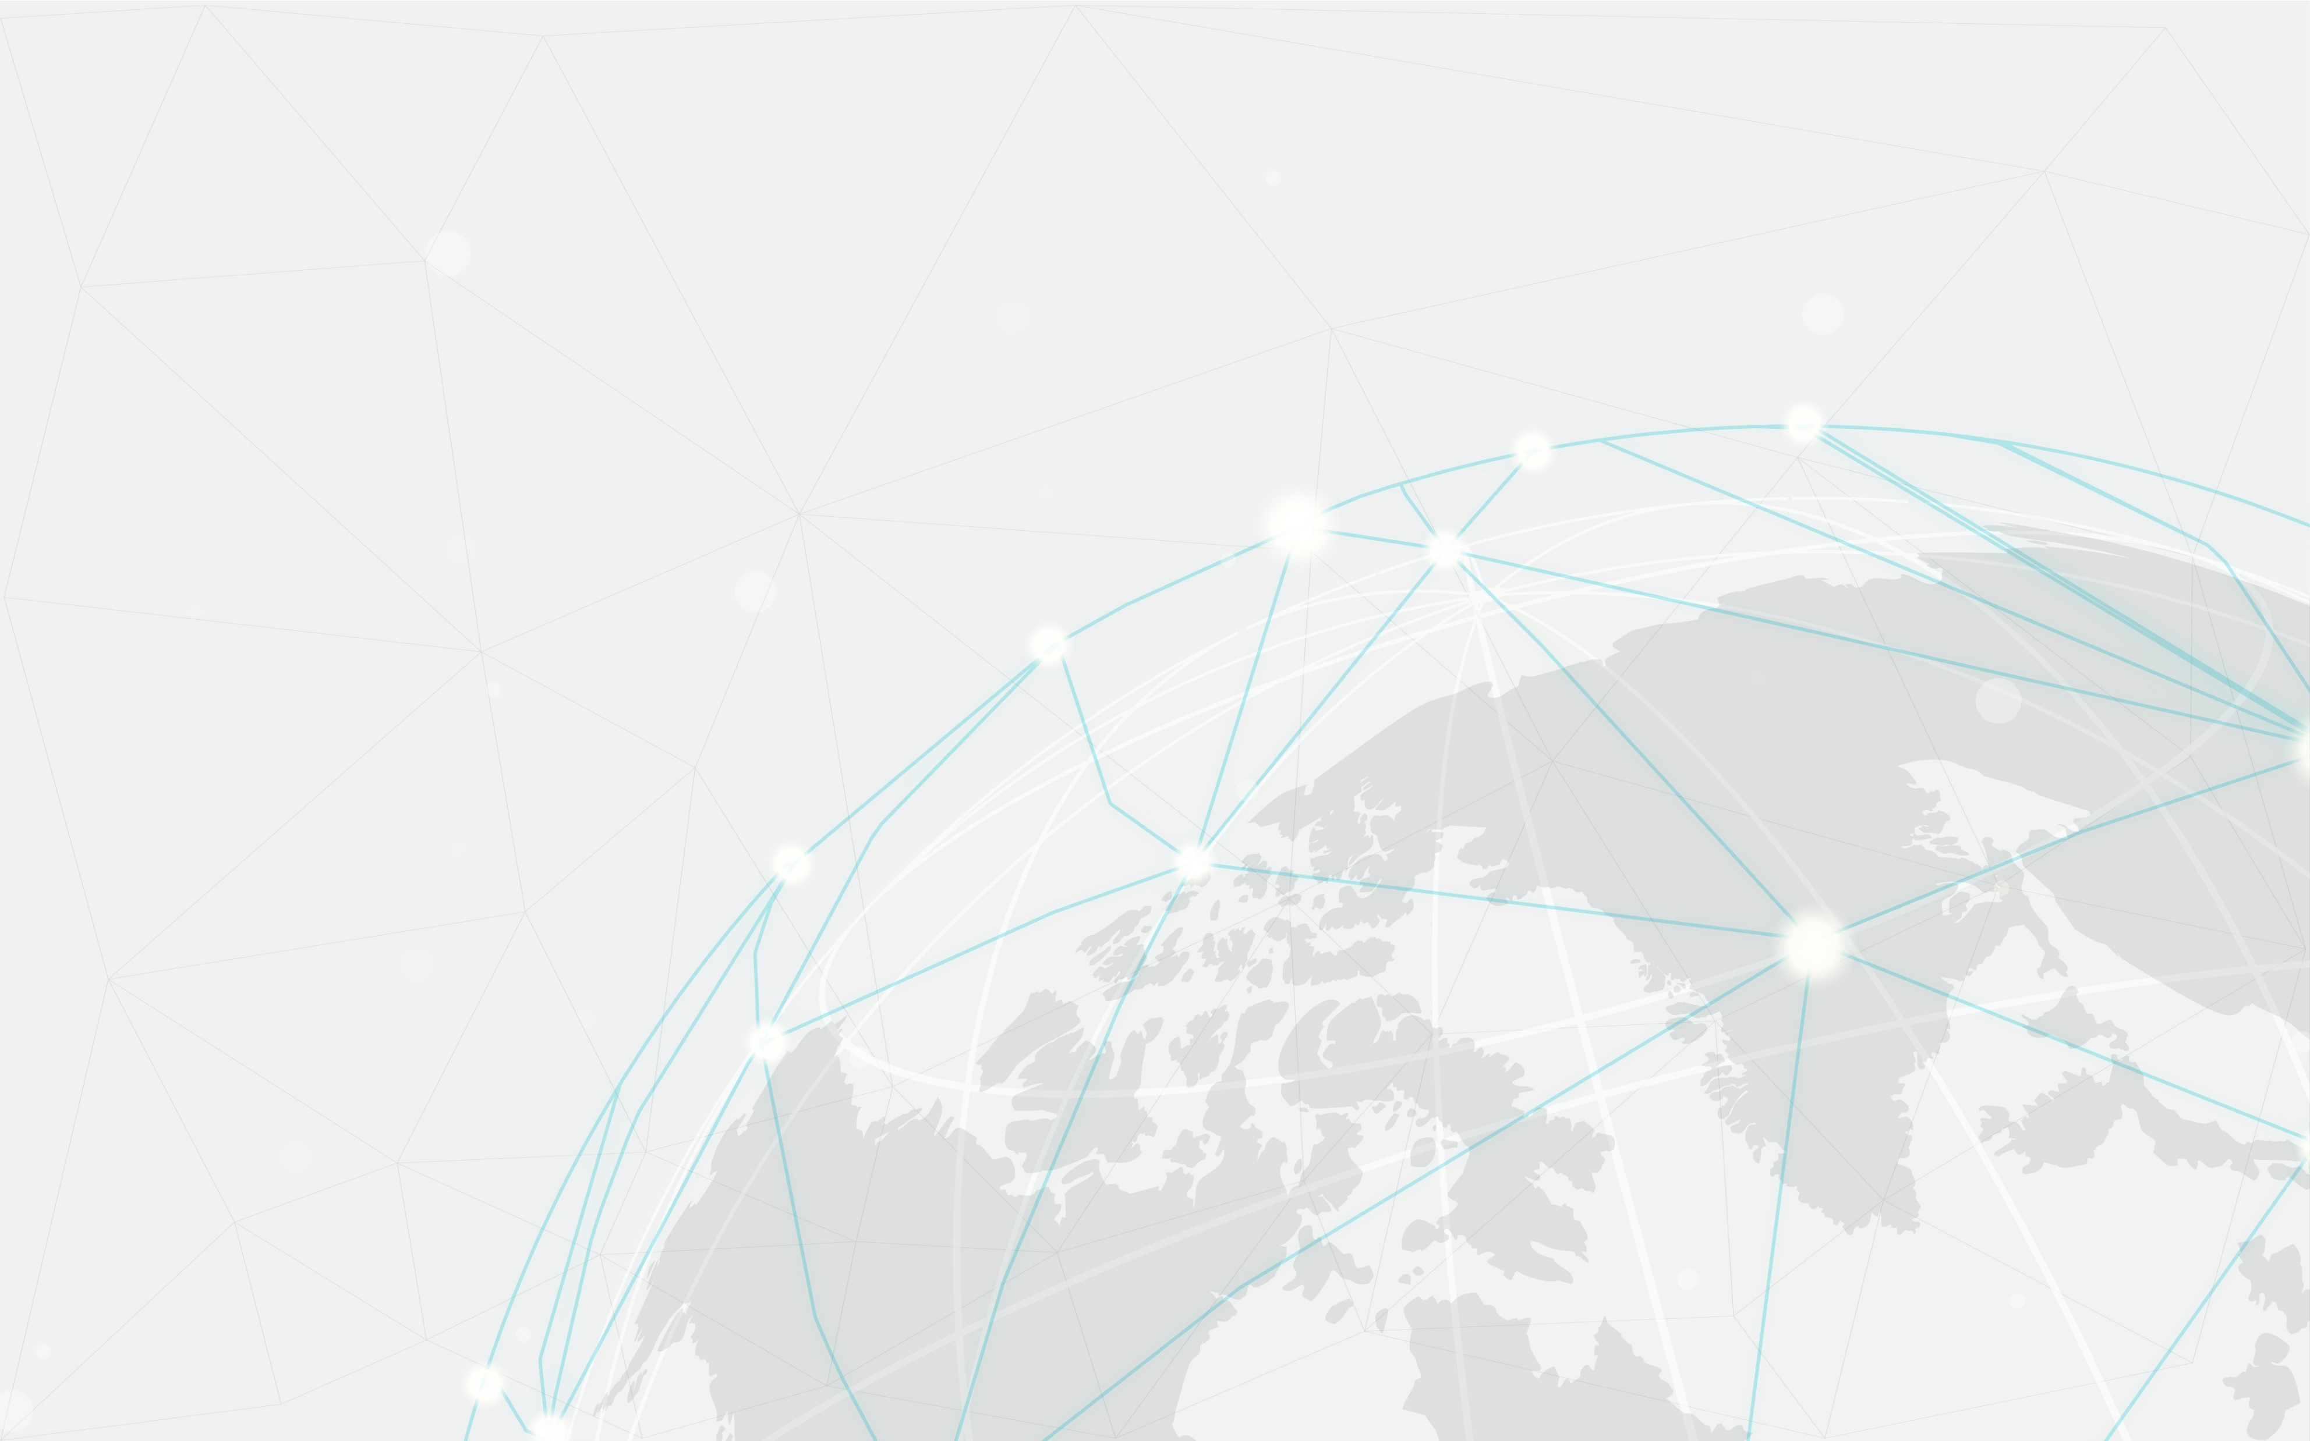
The Analysis
10-year analysis of the operations of companies in the TIDZ (2010 - 2020)
Aiming to make an insight into the economic performance of the companies from DTIDZ, several indicators were analyzed in accordance with the available data from the annual accounts reports of the of DTIDZ clients (a total of 34 entities).
The official documents were provided by the Central Registry of the Republic of Northern Macedonia, after which a database was created which was used to select the necessary indicators and to determine their dynamics through the analyzed period 2010 - 2020.

Slide 22
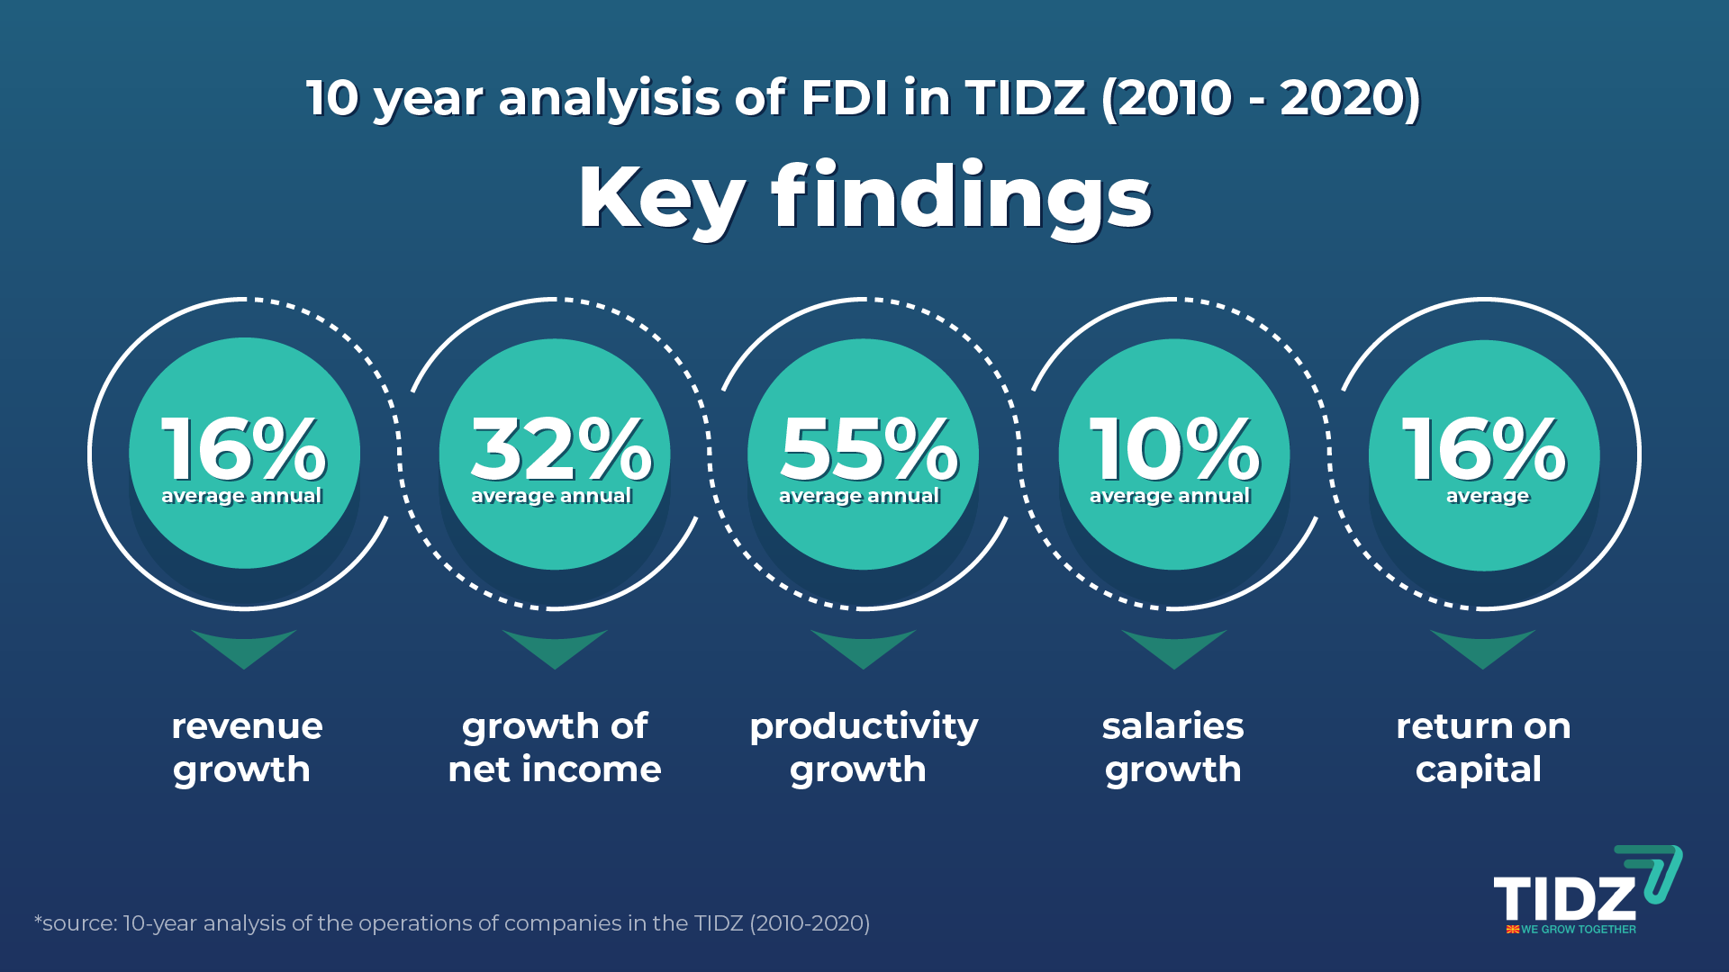

Slide 23

DIRECTORATE FOR TECHNOLOGICAL INDUSTRIAL DEVELOPMENT ZONES
Partizanski Odredi 2, PO Box 311
1000 Skopje, Republic of North Macedonia
Tel.: + 389 2 3111 166
Email: info@fez.gov.mk
Website: www.fez.gov.mk

